Slide 1
Ch. 9 Fundamental of Hypothesis Testing
There two types of statistical inferences, Estimation and Hypothesis Testing
Hypothesis Testing: A hypothesis is a claim (assumption) about one or more population parameters.
  Average price of a six-pack in the U.S. is μ = $4.90
  The population mean monthly cell phone bill of this city is: μ = $42
  The average number of TV sets in U.S. Homes is equal to three; μ = 3
Admission.edhole.com

Slide 2
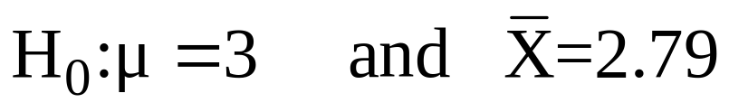
It Is always about a population parameter, not about a sample statistic
Sample evidence is used to assess the probability that the claim about the population parameter is true
A. It starts with Null Hypothesis, H₀
We begin with the assumption that H₀ is true and any difference between the sample statistic and true population parameter is due to chance and not a real (systematic) difference.
Similar to the notion of “innocent until proven guilty”
That is, “innocence” is a null hypothesis.
Admission.edhole.com

Slide 3
Null Hypo, Continued
Refers to the status quo
Always contains “=” , “≤” or “≥” sign
May or may not be rejected
B. Next we state the Alternative Hypothesis, H₁
Is the opposite of the null hypothesis
  e.g., The average number of TV sets in U.S. homes is not equal to 3 ( H₁: μ ≠ 3 )
Challenges the status quo
Never contains the “=” , “≤” or “≥” sign
May or may not be proven
Is generally the hypothesis that the researcher is trying to prove. Evidence is always examined with respect to H₁, never with respect to H₀.
We never “accept” H₀, we either “reject” or “not reject” it
Admission.edhole.com

Slide 4
Summary:
In the process of hypothesis testing, the null hypothesis initially is assumed to be true
Data are gathered and examined to determine whether the evidence is strong enough with respect to the alternative hypothesis to reject the assumption.
In another words, the burden is placed on the researcher to show, using sample information, that the null hypothesis is false.
If the sample information is sufficient enough in favor of the alternative hypothesis, then the null hypothesis is rejected. This is the same as saying if the persecutor has enough evidence of guilt, the “innocence is rejected.
Of course, erroneous conclusions are possible, type I and type II errors.
Admission.edhole.com

Slide 5
Reason for Rejecting H₀
Illustration: Let say, we assume that average age in the US is 50 years (H0=50). If in fact this is the true (unknown) population mean, it is unlikely that we get a sample mean of 20. So, if we have a sample that produces an average of 20, them we reject that the null hypothesis that average age is 50. (note that we are rejecting our assumption or claim). (would we get 20 if the true population mean was 50? NO. That is why we reject 50)
How Is the Test done?
We use the distribution of a Test Statistic, such as Z or t as the criteria.
Admission.edhole.com

Slide 6
A. Rejection Region Method:
Divide the distribution into rejection and non-rejection regions
Defines the unlikely values of the sample statistic if the null hypothesis is true, the critical value(s)
  Defines rejection region of the sampling distribution
Rejection region(s) is designated by α , (level of significance)
  Typical values are .01, .05, or .10
α is selected by the researcher at the beginning
α provides the critical value(s) of the test
Admission.edhole.com

Slide 7
Rejection Region or Critical Value Approach:
Level of significance = α
Non-rejection region
Represents
critical value
a
H₀: μ = 12 H₁: μ ≠ 12
a
/2
/2
Two-tail test
0
H₀: μ ≤ 12 H₁: μ > 12
a
Rejection region is shaded
Upper-tail test
0
H₀: μ ≥ 12 H₁: μ < 12
a
Lower-tail test
0
Admission.edhole.com

Slide 8
P-Value Approach –
    P-value=Max. Probability of (Type I Error), calculated from the sample.
Given the sample information what is the size of blue are?
H₀: μ = 12 H₁: μ ≠ 12
Two-tail test
0
H₀: μ ≤ 12 H₁: μ > 12
Upper-tail test
0
H₀: μ ≥ 12 H₁: μ < 12
0
Admission.edhole.com

Slide 9
Type I and II Errors:
The size of α , the rejection region, affects the risk of making different types of incorrect decisions.
Type I Error
  Rejecting a true null hypothesis when it should NOT be rejected
  Considered a serious type of error
  The probability of Type I Error is α
  It is also called level of significance of the test
Type II Error
  Fail to reject a false null hypothesis that should have been rejected
  The probability of Type II Error is β
Admission.edhole.com

Slide 10
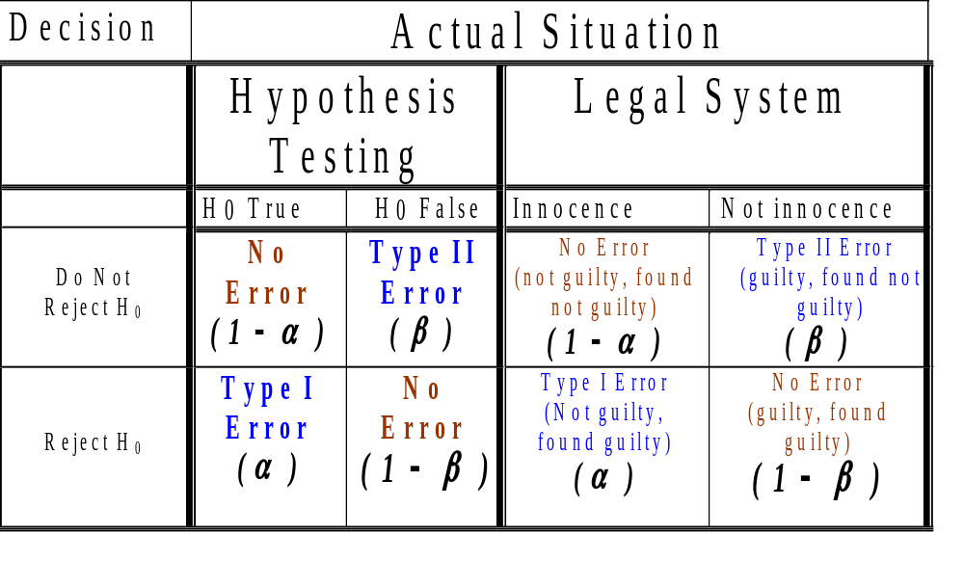
Admission.edhole.com
Admission.edhole.com

Slide 11
Type I and Type II errors cannot happen at the same time
  Type I error can only occur if H₀ is true
  Type II error can only occur if H₀ is false
  There is a tradeoff between type I and II errors. If the probability of type I error ( α ) increased, then the probability of type II error ( β ) declines.
  When the difference between the hypothesized parameter and the actual true value is small, the probability of type two error (the non-rejection region) is larger.
  Increasing the sample size, n, for a given level of α, reduces β
Admission.edhole.com

Slide 12
B. P-Value approach to Hypothesis Testing:
The rejection region approach allows you to examine evidence but restrict you to not more than a certain probability (say α = 5%) of rejecting a true H₀ by mistake.
The P-value approach allows you to use the information from the sample and then calculate the maximum probability of rejecting a true H₀ by mistake.
Another way of looking at P-value is the probability of observing a sample information of “A=11.5” when the true population parameter is “12=B”. The P-value is the maximum probability of such mistake taking place.
Admission.edhole.com

Slide 13
That is to say that P-value is the smallest value of α for which H₀ can be rejected based on the sample information
Convert Sample Statistic (e.g., sample mean) to Test Statistic (e.g., Z statistic )
Obtain the p-value from a table or computer
Compare the p-value with α
  If p-value < α , reject H₀
  If p-value ≥ α , do not reject H₀
Admission.edhole.com

Slide 14
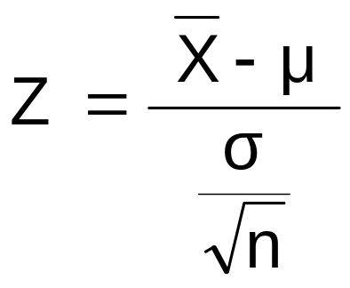
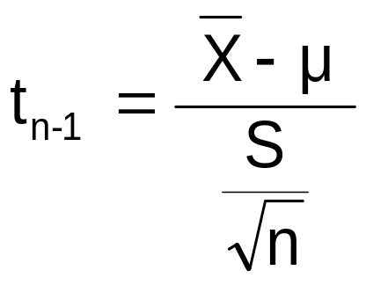
Test of Hypothesis for the Mean
σ known
σ Unknown
The test statistic is:
The test statistic is:
Admission.edhole.com

Slide 15
Steps to Hypothesis Testing
State the H₀ and H₁ clearly
Identify the test statistic (two-tail, one-tail, and Z or t distribution
Depending on the type of risk you are willing to take, specify the level of significance,
Find the decision rule, critical values, and rejection regions. If –CV<actual value (sample statistic) <+CV, then do not reject the H₀
Collect the data and do the calculation for the actual values of the test statistic from the sample
Admission.edhole.com

Slide 16
Steps to Hypothesis testing, continued
Make statistical decision
Do not Reject H₀
Reject H₀
Conclude H₀ may be true
Conclude H₁ is “true”
(There is sufficient evidence of H1)
Make management/business/administrative decision
Admission.edhole.com

Slide 17
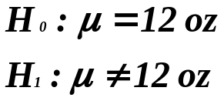
When do we use a two-tail test? when do we use a one-tail test?
The answer depends on the question you are trying to answer.
A two-tail is used when the researcher has no idea which direction the study will go, interested in both direction. (example: testing a new technique, a new product, a new theory and we don’t know the direction)
A new machine is producing 12 fluid once can of soft drink. The quality control manager is concern with cans containing too much or too little. Then, the test is a two-tailed test. That is the two rejection regions in tails is most likely (higher probability) to provide evidence of H_{1.}
12
Admission.edhole.com

Slide 18
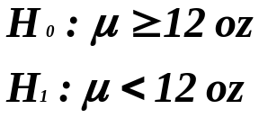
One-tail test is used when the researcher is interested in the direction.
Example: The soft-drink company puts a label on cans claiming they contain 12 oz. A consumer advocate desires to test this statement. She would assume that each can contains at least 12 oz and tries to find evidence to the contrary. That is, she examines the evidence for less than 12 0z.
What tail of the distribution is the most logical (higher probability) to find that evidence? The only way to reject the claim is to get evidence of less than 12 oz, left tail.
11.5
12
14
Admission.edhole.com

Slide 19
Review of Hypo. Testing
What is HT?
Probability of making erroneous conclusions
    Type I – only when Null Hypo is true
    Type II – only when Null Hypo is false
Two Approaches
    The Rejection or Critical Value Approach
    The P-value Approach (we calculate the observed level of significance)
Test Statistics
    Z- distribution if Population Std. Dev. is Know
    t-distribution if the Population Std. Dev. is unknown
Admission.edhole.com

Slide 20
Rejection Region or Critical Value Approach:
The given level of significance = α
Non-rejection region
Represents
critical value
a
H₀: μ = 12 H₁: μ ≠ 12
a
/2
/2
Two-tail test
0
H₀: μ ≤ 12 H₁: μ > 12
a
Rejection region is shaded
Upper-tail test
0
H₀: μ ≥ 12 H₁: μ < 12
a
Lower-tail test
0
Admission.edhole.com

Slide 21
P-Value Approach –
    P-value=Max. Probability of (Type I Error), calculated from the sample.
Given the sample information what is the size of the blue areas? (The observed level of significance)
H₀: μ = 12 H₁: μ ≠ 12
Two-tail test
0
H₀: μ ≤ 12 H₁: μ > 12
Upper-tail test
0
H₀: μ ≥ 12 H₁: μ < 12
0
Admission.edhole.com

Slide 22
Example 1:
Let’s assume a sample of 25 cans produced a sample mean of 11.5 0z and the population std dev=1 0z.
Question 1:
  At a 5% level of significance (that is allowing for a maximum of 5% prob. of rejecting a true null hypo), is there evidence that the population mean is different from 12 oz?
    Null Hypo is:?
    Alternative Hypo is?
  Can both approaches be used to answer this question?
Admission.edhole.com

Slide 23
  A: Rejection region approach: calculate the actual test statistics and compare it with the critical values
  B: P-value approach: calculate the actual probability of type I error given the sample information. Then compare it with 1%, 5%, or 10% level of significance.
  Interpretation of Critical Value/Rejection Region Approach:
  Interpretation of P-value Approach:
Admission.edhole.com
Notes:
With 5% probability of making type I error or at 5% level of significance, there is sufficient evidence that the pop mean is different from 12, thus, we reject the null hypo that it is equal to 12.
If in fact the pop. mean is 12 oz, the probability of getting a sample with mean equal to 11.5 oz (0.5 or more away from 12 in either side) is .0124.

Slide 24
Question 2:
  At a 5% level of significance (that is allowing for a maximum of 5% prob. of rejecting a true null hypo), is the evidence that the population mean is less than 12 oz?
    Null Hypo is:?
    Alternative Hypo is?
  Can both approaches be used to answer this question?
  Interpretation of Critical Value Approach:
  Interpretation of P-value Approach:
Admission.edhole.com
Notes:
With 5% risk of type I error or at 5% level of significance, there is sufficient evidence that the pop mean is less than 12, thus, we reject the null hypo that it s equal to or greater than 12.
If in fact the pop. mean is 12 oz, the probability of getting a sample with mean equal to 11.5 or less oz (0.5 or more smaller than 12) is .0062.

Slide 25
Question 3:
  If in fact the pop. mean is 12 oz, what is the probability of obtaining a sample mean of 11.5 or less oz (sample size 25)? Null
    Null Hypo is:?
    Alternative Hypo is?
Question 4:
  If in fact the pop. mean is 12 oz, and the sample mean is 11.5 (or less), what is the probability of erroneously rejecting the null hypo that the pop. mean is 12 oz?
    Null Hypo is:?
    Alternative Hypo is?
  Can both approaches be used to answer these question?
Admission.edhole.com

Slide 26
Connection to Confidence Intervals
While the confidence interval estimation and hypothesis testing serve different purposes, they are based on same concept and conclusions reached by two methods are consistent for a two-tail test.
In CI method we estimate an interval for the population mean with a degree of confidence. If the estimated interval contains the hypothesized value under the hypothesis testing, then this is equivalent of not rejecting the null hypothesis. For example: for the beer sample with mean 5.20, the confidence interval is:
    P(4.61 ≤ μ ≤ 5.78)=95%
Since this interval contains the Hypothesized mean ($4.90), we do not (did not) reject the null hypothesis at α = .05
Did not reject and within the interval, thus consistent results.
Admission.edhole.com

